Slide 1
Capstone 12/1
Xinran Chen, Tianyu Han, Ying Hong,
Siyu Shen, Shiyuan Xu
From Columbia MS Data Science

Slide 2
Objective
Goal
Using NHANES (from 2003 To 2004) to learn the underlying patterns in psoriasis patients and accurately identify patients
Challenges
Need domain knowledge input
Organize data into one analytics dataset
Build Machine learning model
Check if model results align with domain knowledge
Plan

Slide 3
Machine Learning Model for Classification
Logistic Regression
Random Forests
XGBoost
SVM

Slide 4
Feature Importance - Random Forest & SVM
Most Important Features:
BMXHT: Standing Height (cm)
RIDAGEEX: Exam Age in Months
BMXBMI: Body Mass Index (kg/m**2)
LBDVIDMS: Vitamin D (nmol/L)
RIAGENDR: Gender
SMQ020: Smoked at least 100 cigarettes in life
DEQ038G: In the past yr did you have sunburn?
ALQ150: Ever have 5 or more drinks every day?

Slide 5

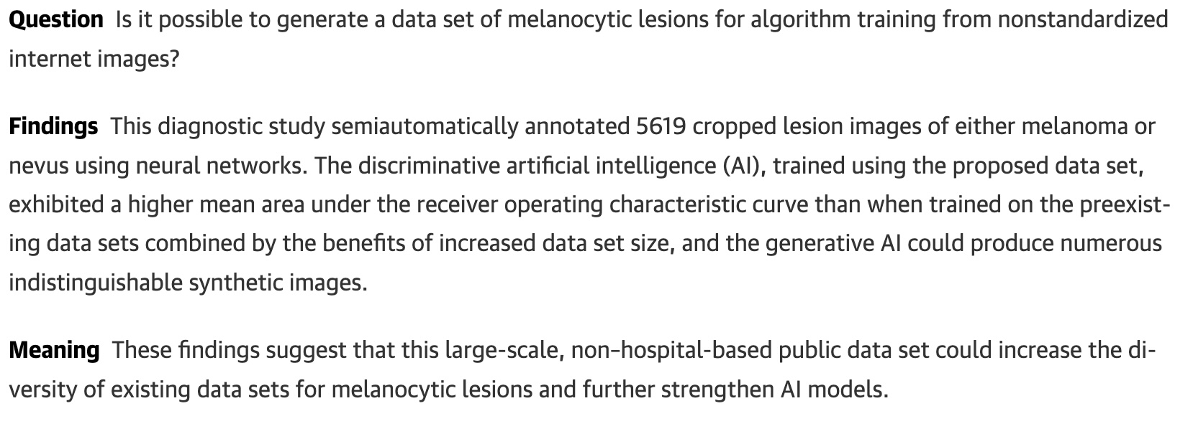
Next Step - CNN image classification for psoriasis

